Slide 1



Service verification for PCS: Time/Task Sheets

Slide 2
Mandatory reporting items that a provider must retain for each episode of personal care:
Rule 173-39-02.11 - Ohio Administrative Code | Ohio Laws
173-39-02.11 (C)(6)(a)(i-vii)
Service date
PCA's arrival time
PCA's departure time
Description of the activities provided
Name of each PCA in contact with the individual
Unique identifier of each PCA in contact with the individual to attest to the accuracy of the record
Unique identifier of the individual

Slide 3
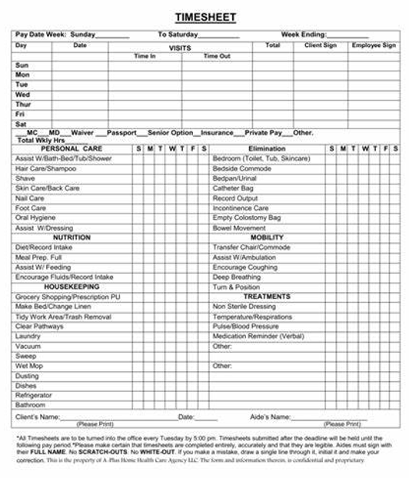
Example:

